Slide 1
Session 5
Intellectual Merit and Broader Significance
FISH 521

Slide 2
Further plans
Feb 9: Intellectual Merit and Broader Impact
  Due Thursday
Feb 16: Holiday
  Full proposal draft (Thursday)
Feb 23: Penny Dalton
  Full proposal ➔ review panel
March 2: Peer review
  Full proposal + reviews ➔ decision panel
March 9: Panel reviews
  Evaluations online

Slide 3
NSF Merit Review Criteria
Intellectual Merit
  Scientific merit of the proposal
Broader Impact
  ‘outreach’, public understanding of science, engagement plan
Why is this important?
  Almost all other agencies want something similar
    Your tax dollars at work
    Keep stakeholders happy
    Foundations: show all the good work they are doing
  NSF is leading the pack
    Other agencies are likely to follow

Slide 4

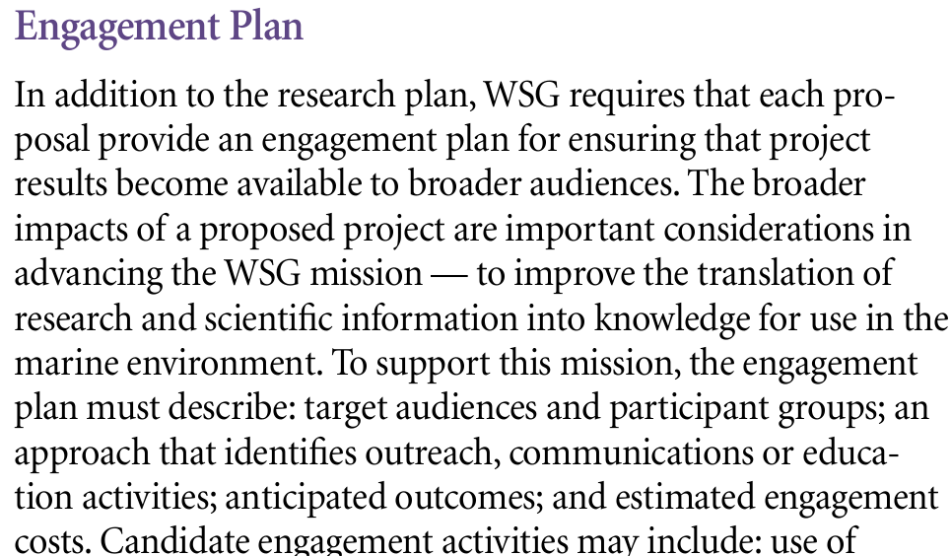


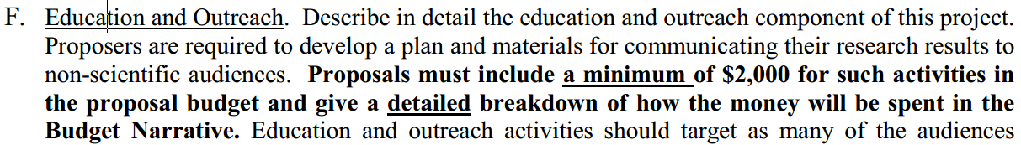
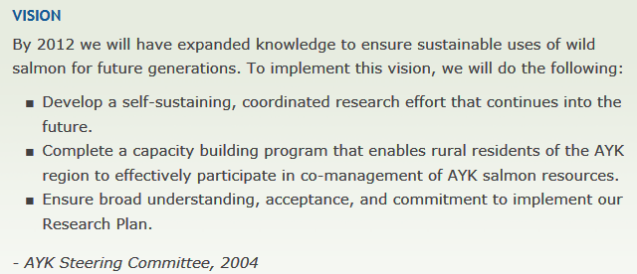


Slide 5
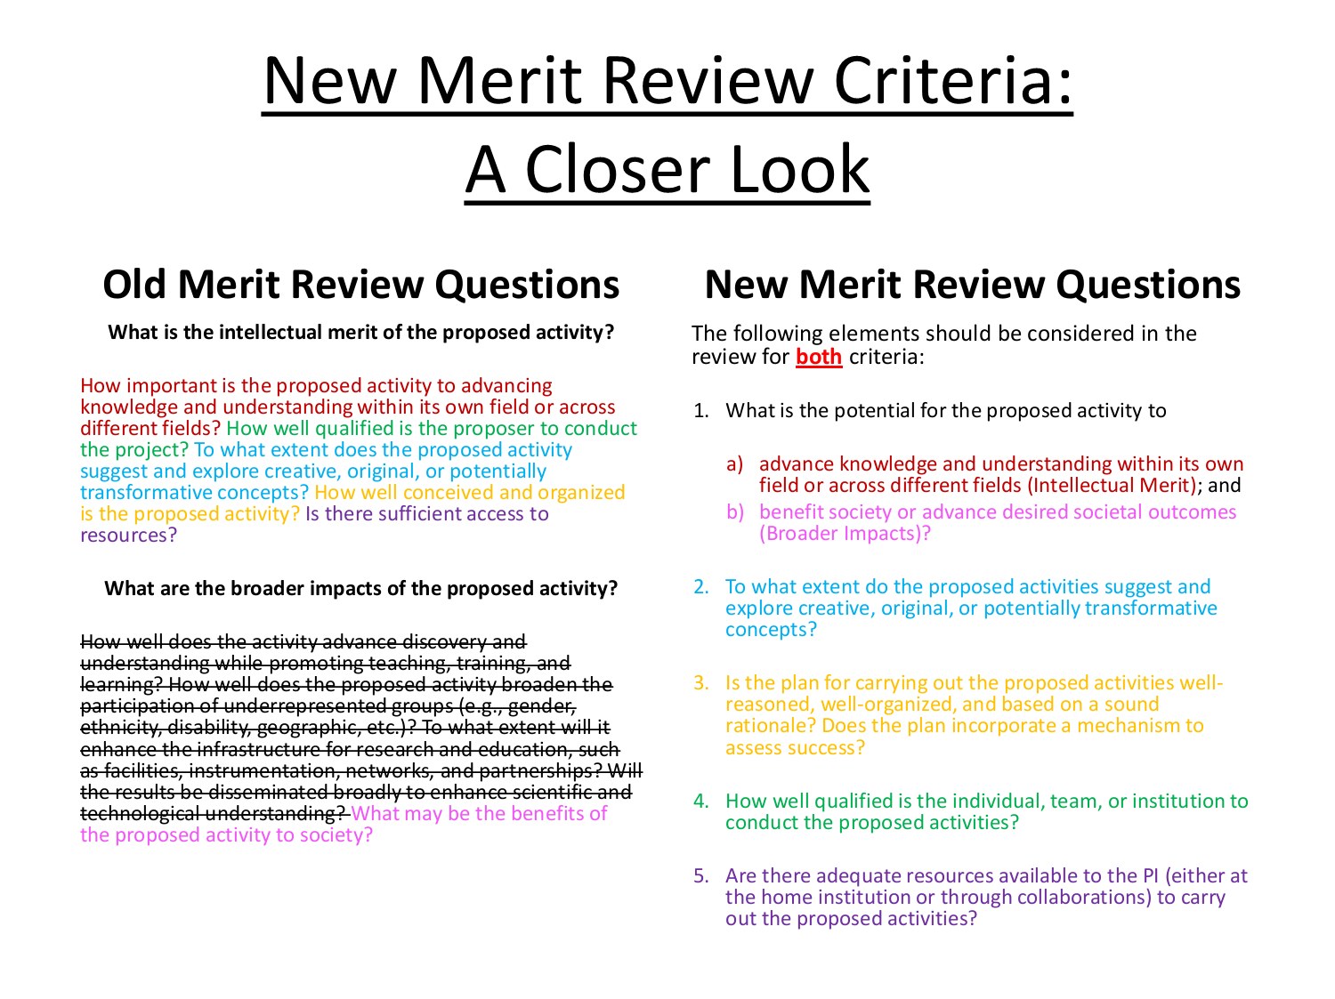

Slide 6
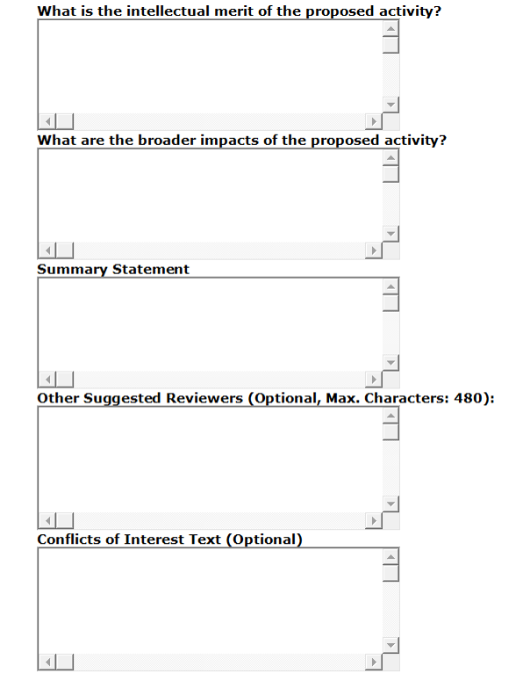
NSF Reviewer form
3 points
  Intellectual merit
  Broader impact
  Summary statement
Re-emphasized to panelists
Think about it carefully
  Include in other aspects of proposal
New: similar forms for project summary
  Summary
  Intellectual Merit
  Broader Impact

Slide 7
Intellectual Merit
Potential
  Importance to advancing knowledge within field or across different fields
  Evidence for creative, original or potentially transformative concepts
  Show the wider scientific impact of your project
    Link to significance statement / intro
    Provide alternative hook
  Not just stamp collecting
    Must be important beyond your system
  Potentially transformative concepts
    Revolutionize entire disciplines
    Creating entire new fields
    Disrupting accepted theories

Slide 8
Intellectual Merit
Feasibility
  Concept and organization of research
  Qualifications of investigator
  Access to resources
  Can it be done?
  Does proposal show testable hypotheses, a good work plan and good presentation?

Slide 9
G. Muller-Parker, NSF

Slide 10
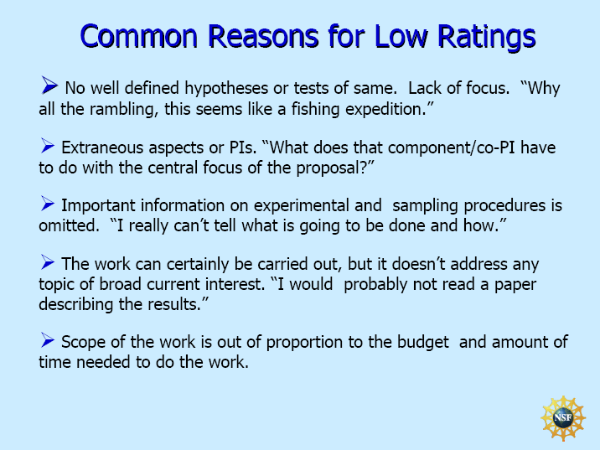
G. Muller-Parker, NSF

Slide 11
Broader impact
G. Muller-Parker, NSF

Slide 12
Broader Impact
NSF GPG
What is the potential for the proposed activity 1.b. to benefit society or advance desired societal outcomes?
To what extent do the proposed activities suggest and explore creative, original, or potentially transformative concepts?
Is the plan for carrying out the proposed activities well-reasoned, well-organized, and based on a sound rationale? Does the plan incorporate a mechanism to assess success?
How well qualified is the individual, team, or organization to conduct the proposed activities?
Are there adequate resources available to the PI (either at the home organization or through collaborations) to carry out the proposed activities?
Aim
Rationale
  Preliminary data
Workplan
Resources, qualifications etc

Slide 13
What are ‘desired societal outcomes’?
Varies among funding agencies
  Common themes
    Outreach, public scientific education
    Involvement of underrepresented minorities
    Integration of learning and teaching
NSF
    Advance discovery and understanding while promoting teaching, training, and learning;
    Broaden participation of underrepresented groups;
    Enhance infrastructure for research and education;
    Broad dissemination to enhance scientific and technological understanding; and
    Benefits to society.

Slide 14
Check out strategic plans
NSF performance goals
  (NSF strategic plan 2014-2018)
  Transform the frontiers of science
    Invest in fundamental research to ensure significant continuing advances across science, engineering, and education
    Integrate education and research to support development of a diverse STEM workforce with cutting-edge capabilities
    Provide world-class research infrastructure to enable major scientific advances.
  Innovate for society
    Strengthen the links between fundamental research and societal needs through investments and partnerships.
    Build the capacity of the Nation to address societal challenges using a suite of formal, informal, and broadly available STEM educational mechanisms
Make sure to read plans
  And explicitly refer to them

Slide 15
Integrating broader impacts
Ideally should be part of project
  Collaboration / Assistance by underrepresented groups
  Using some study sites as outreach/teaching sites
  Dissemination to non-scientific audiences
    Lawmakers, public managers, media
Collaborate
  There are people who do this for a living
    Outreach programs (e.g. Sea Grant, COMPASS)
    Teachers
    Aquariums, zoos
Consider in budget
  Hire assistance
  Allow for costs
  Don’t overdo it
Not
  Graduate student education
  Talks at scientific meetings and workshops
  Publications in peer reviewed journals
  Website

Slide 16
Conclusion
Broader impact won’t save your proposal if the science is bad
However, a good broader impact statement may save your proposal if you are in the grey zone
  Not only NSF
  http://coseenow.net/wizard/
  Any ideas?

Slide 17
Your proposal
Write 1-2 pages IM and BI
Intellectual Merit
  After describing the details, what’s the cool scientific aspect (transformative) of your research?
  Why are you the best person to do it (expertise (preliminary data), resources, access to sites, etc)?
Broader Impact
  What is your objective?
  What will you do?
  Why can you do it?
  What is the expected outcome?

Slide 18
Panel Exercise
Work Plan vs Budget
  Discuss link and justifiability of objectives
  Discuss link to objectives
  Discuss specificity
Intellectual Merit & Broader Impact
  Discuss in connection to work plan & budget
    revise
  Reconsider what you wrote in the summary

